Slide 1

Module 4
Test Execution and Planning

Slide 2
Text Book
Software Testing and Analysis- Process, Principles and Techniques
By,
Mauro Pezze
Michal Young

Slide 3
Test Execution ch-17

Slide 4
TEST EXECUTION
Overview
From Test Case Specifications to Test Cases
Scaffolding
Generic Vs Specific Scaffolding
Test Oracles
Self Checks as Oracles
Capture and Replay

Slide 5
What is Test Execution Phase?
Test execution is, without doubt, the most important and ‘happening’ phase in the STLC and the entire development lifecycle.
“ The entire teamwork is validated here”

Slide 6
In Test Execution Phase
Has the Business Analyst interpreted the requirements correctly?
Has the development team translated the business requirements to functional requirement and eventually to code correctly?
Has the data architect and DBAs designed the right back-end systems?

Slide 7
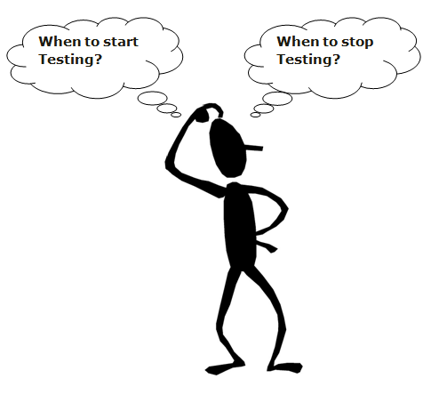
ProfessionalQA.com

Slide 8
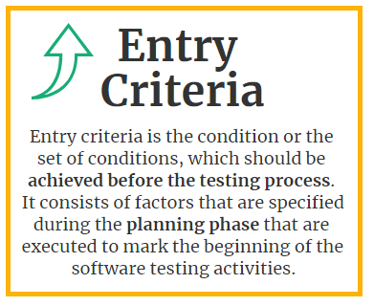
Entry Criteria

Slide 9
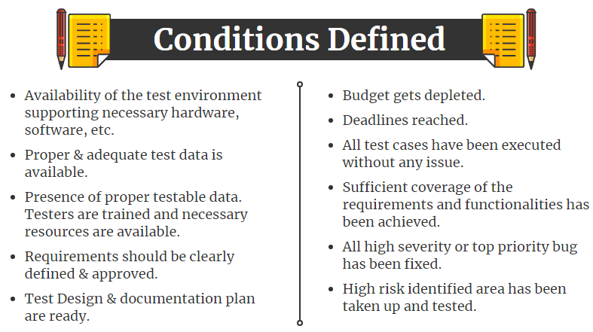
professionalQA.com

Slide 10
What is Test Execution Phase?
Executing the test scripts + test script maintenance (correct gaps in the scripts) + reporting (defects, status, metrics, etc.)

Slide 11
Steps typically in Test Execution Phase
Build(AUT)
Dedicated Environment
Team Size
2 cycles of test execution
TRR
Smoke and Sanity Testing
Exploratory Testing

Slide 12
Objective
Creating the run-time support for generating and managing test data
Creating scaffolding for test execution
Automatically distinguishing between correct and incorrect test case executions

Slide 13
1. Overview
Designing test cases and test suites is creative – Like any design activity: A demanding intellectual activity, requiring human judgment
Executing test cases should be automatic – Design once, execute many times
Test automation separates the creative human process from the mechanical process of test execution

Slide 14
1. Overview
Automated Tests Execution
a tool that can run tests
Reasons for using a test execution engine:
Test results are stored and can be viewed in a uniform way, independent of the type of the test
Easier to keep track of the changes
Easier to reuse components developed for testing
Test Specification and Test Data are stored in a Test Repository

Slide 15
2. From Test Case Specifications to Test Cases
Test design often yields test case specifications, rather than concrete data
Ex: “a large positive number”, not 420023
While test case design involve judgment and creativity, test case generation should be a mechanical step
Helps reduce the impact of small interface changes in the course of development
Test cases should be more generalized with respect to specification which reduces the impact of small interface changes in development process.
Test cases that satisfy several constraints may be simple if constraints are independent.
But if multiple constraints apply to the same item it difficult.

Slide 16
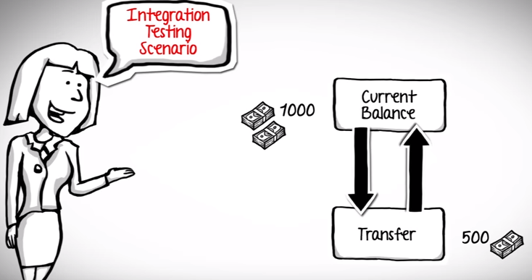

Slide 17
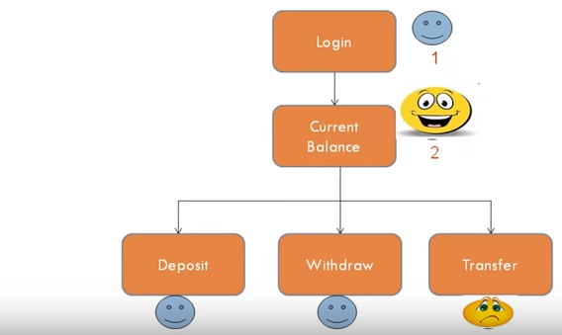

Slide 18
Purpose of scaffolding
Purpose is to provide controllability to execute test cases and observability to judge the outcome.
Make the module executable
Check the interfaces

Slide 19
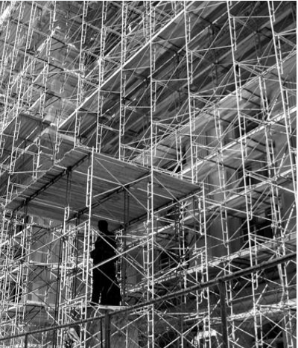
3. Scaffolding
Code produced to support development activities (especially testing)
Not part of the product as seen by the end user
May be temporary (like scaffolding in construction of buildings
Includes – Test harnesses, drivers, and stubs

Slide 20
What is scaffolding?
Code developed to facilitate testing is called scaffolding, by analogy to the temporary structures erected around a building during construction or maintenance.
Scaffoldings may include
1)Test drivers (substituting for a main or calling population)
2)Test harness (substituting for parts of the deployment environment)
3)Stubs (substituting for functionally called or used by the software under test.

Slide 21
3. Scaffolding ...
Sometimes scaffolding is required to simply make module executable, but even in incremental development with immediate integration of each module, scaffolding for controllability and observability may be required because the external interfaces of the system may not provide sufficient control to drive the module under test through test cases, or sufficient observability of the effect.
Test driver
Substituting A “main” program for running a test
Test stubs
Substitute for called functions/methods/objects
Test harness
Substitutes for other parts of the deployed environment
Ex: Software simulation of a hardware device
=================================

Slide 22
4. Generic Vs Specific Scaffolding
At least some level of generic scaffolding support can be used across a fairly wide class of applications
For large test suites writing each test case and a scaffold for each is impractical.
Fully generic scaffolding may suffice for small numbers of hand-written test cases .The simplest form of scaffolding is a driver program that runs a single, specific test case .

Slide 23

It is not the strongest of the species that survives, nor the most intelligent , but the one most responsive to change.

Slide 24

5. Test Oracles
Software that applies a pass/fail criterion to a program execution is called a test oracle/ oracle
A test oracle may apply a pass/fail criterion that reflects only a part of the actual program specification, or is an approximation, and therefore passes some program executions it ought to fail
The best oracle we can obtain is an oracle that detects deviations from expectation that may or may not be actual failure
Helpful in:-
Automated test oracles make it possible to classify behaviors that exceed human capacity
Generates Voluminous output data in a machine readable form

Slide 25
Test oracles
It is used to execute a test suite automatically if execution results may be manually inspected to apply a pass/fail criterion.
Relying on human intervention to judge test outcomes is not merely expensive, but also unreliable.
person cannot maintain the level of attention required to identify one failure in a hundred program executions, little more one or ten thousand. That is a job for a computer.
Software that applies a pass/fail criterion to a program execution is called a test oracle, often shortened to oracle

Slide 26
Types: Comparison based oracle
With a comparison based oracle , we need predicted output for each input
Oracle compares actual to predicted output, and reports failure if they differ.
It is best suited for small number of hand generated test cases example: for handwritten Junit test cases.
Comparison based oracle are used mainly for small, simple test cases
Expected outputs can also be produced for complex test cases and large test suites but its no efficient as its difficult to predict output for thousands of test cases.
Capture-replay testing, a special case in which the predicted output or behaviour is preserved from an earlier execution
Often possible to judge output or behaviour without predicting it

Slide 27
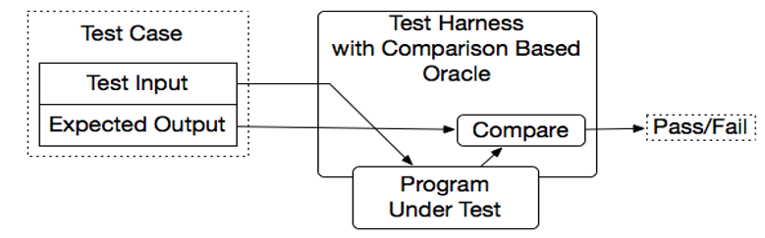
Comparison-based oracle

Slide 28
Partial oracle
Oracles that check results without references to predicted output are often partial, in the sense that they can detect some violations of the actual specification but not others.
They check necessary conditions for correctness.
A cheap partial oracle that can be used for a large number of test cases is often combined with a more expensive comparison-based oracle that can be used with a smaller set of test cases for which predicted output has been obtained
Specifications are often incomplete
Automatic derivations of test oracles are impossible
Notes:
A necessary condition for some state of affairs S is a condition that must be satisfied in order for S to obtain.
A sufficient condition for some state of affairs S is a condition that, if satisfied, guarantees that S obtains.

Slide 29
Self checking oracle
An oracle can also be written as self checks
Often possible to judge correctness without predicting results.
Typically these self checks are in the form of assertions, but designed to be checked during execution.
Assertion is Boolean expression at a point in program which will be true unless there is bug.
It is generally considered good design practice to make assertions and self checks to be free of side effects on program state.
Self checks in the form of assertions embedded in program code are useful primarily for checking module and subsystem-level specification rather than all program behaviour.

Slide 30
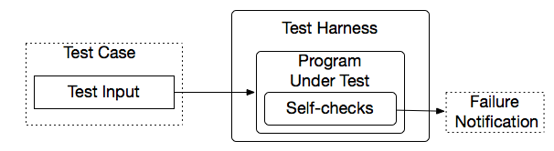
Self-Checking Code as Oracle
An oracle can also be written as self-checks
Often possible to judge correctness without predicting results
Advantages and limits: Usable with large, automatically generated test suites, but often only a partial check
Self checks are assertions which are useful for module, subsystem level specifications rather for overall behavior of software.
Notes:
A typical approach is to add a few hand-written test cases with a comparison-based test oracle, to cover properties that are difficult or too expensive to check with a general oracle.

Slide 31
Contd..
Self checks are written at function level, for a method or properties.
Public void mutltiplicationofzero()
{
assertEquals(“10*0 must be 0”,0,testmultiply(10,0));
assertEquals(“0*0 must be 0”,0,testmultiply(0,0));
}
Public void propertiesOSort(string[] ip)
{
string[] sorted=quicksort(ip);
assert(sorted.size==0, “This array cannot be empty”
}

Slide 32
Capture and Replay
Sometimes there is no alternative to human input and observation
– Even if we separate testing program functionality from GUI, some testing of the GUI is required
We can at least cut repetition of human testing
Capture a manually run test case, replay it automatically

Slide 33
Capture and Replay
Sometimes it is difficult to either devise a precise description of expected behaviour or adequately characterize correct behaviour for effective self checks.
Example: even if we separate testing program functionally from GUI, some testing of the GUI is required.
If one cannot completely avoid human involvement test case execution, one can at least avoid unnecessary repetition of this cost and opportunity for error.
The principle is simple:
The first time such a test case is executed, the oracle function is carried out by a human, and the interaction sequence is captured. Provided the execution was judged (by human tester) to be correct, the captured log now forms an (input, predicted output) pair for subsequent automated testing.
The savings from automated retesting with a captured log depends on how many build-and-test cycles we can continue to use it, before it is invalidated by some change to the program.

Slide 34
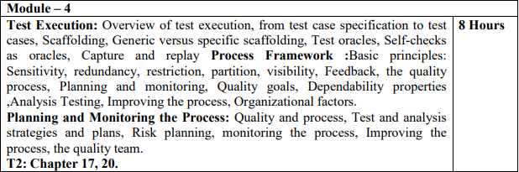
Syllabus

Slide 35
Basic Principles

Slide 36
Text Book
Software Testing and Analysis- Process, Principles and Techniques
By,
Mauro Pezze
Michal Young

Slide 37
What is Regression Testing?
Regression Testing is defined as a type of software testing to confirm that a recent program or code change has not adversely affected existing features.
Regression Testing is nothing but a full or partial selection of already executed test cases which are re-executed to ensure existing functionalities work fine.
This testing is done to make sure that new code changes should not have side effects on the existing functionalities. It ensures that the old code still works once the new code changes are done.

Slide 38
Why do we have to understand Analysis Principles when we carry out testing?
How does analysis help in doing testing activities?

Slide 39
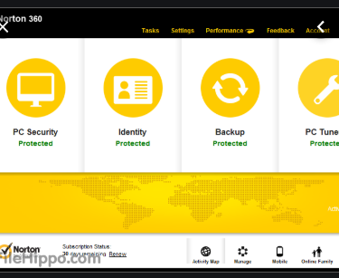
Regression Analysis
Earlier Version

Slide 40
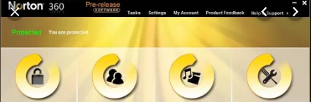
How to find which test cases to test?

Slide 41
Basic Principles-chapter 2
Mature engineering disciplines are characterized by basic principles.
Principles provide a rationale for defining, selecting, and applying techniques and methods.
They are valid beyond a single technique and over a time span in which techniques come and go, and can help engineers' study, define, evaluate, and apply new techniques.

Slide 42
Principles
Partition: divide and conquer
Visibility: making information accessible
Feedback: tuning the development process
Sensitivity: better to fail every time than sometimes
Redundancy: making intentions explicit
Restriction: making the problem easier

Slide 43
Sensitivity: Better to fail every time than sometimes
Human developers make errors, producing faults in software.
Faults may lead to failures, but faulty software may not fail on every execution.
The sensitivity principle states that it is better to fail every time than sometimes.

Slide 44
#include <assert.h>
char before[ ] = "=Before=";
char middle[ ] = "Middle";
char after[ ] = "=After=";
void show() {
printf("%s\n%s\n%s\n", before, middle, after);
}
void stringCopy(char *target, const char *source, int howBig);
int main(int argc, char *argv) {
show();
strcpy(middle, "Muddled");
show();
strncpy(middle, "Muddled", sizeof(middle)); show();
stringCopy(middle, "Muddled",sizeof(middle)); show();

Slide 45
Sensitivity
For example, a fault that results in a failure only for some unusual configurations of customer equipment may be difficult and expensive to detect. Consider the cost of detecting and repairing a software fault.
If it is detected immediately (e.g., by an on-the-fly syntactic check in a design editor), then the cost of correction is very small.
If a fault is detected in inspection or unit testing, the cost is still relatively small.

Slide 46
Sensitivity
If a fault survives initial detection efforts at the unit level, but triggers a failure detected in integration testing, the cost of correction is much greater.
If the first failure is detected in system or acceptance testing, the cost is very high indeed, and the most costly faults are those detected by customers in the field.
A fault that triggers a failure on every execution is unlikely to survive past unit testing.
A characteristic of faults that escape detection until much later is that they trigger failures only rarely, or in combination with circumstances that seem unrelated or are difficult to control.

Slide 47
Sensitivity
The sensitivity principle says that we should try to make these faults easier to detect by making them cause failure more often.
It can be applied in 3 ways:
At design level, changing the way in which the program fails;
At the analysis and testing level, choosing a technique more reliable with respect to the property of interest
Environment level, choosing a technique that reduces the impact of external factors on the results.

Slide 48
Redundancy-Making Intensions Explicit
Redundancy is the opposite of independence. If one part of a software artifact (program, design document, etc.) constrains the content of another, then they are not entirely independent, and it is possible to check them for consistency.
The concept and definition of redundancy are taken from information theory.
In communication, redundancy can be introduced into messages in the form of error detecting and error-correcting codes to guard against transmission errors.
In software test and analysis, we wish to detect faults that could lead to differences between intended behavior and actual behavior, so the most valuable form of redundancy is in the form of an explicit, redundant statement of intent.

Slide 49
Redundancy-Making Intensions Explicit
Static type checking is a classic application of this principle: The type declaration is a statement of intent that is at least partly redundant with the use of a variable in the source code.
The type declaration constrains other parts of the code, so a consistency check (type check) can be applied.

Slide 50
Redundancy-Making Intensions Explicit
An important trend in the evolution of programming languages is introduction of additional ways to declare intent and automatically check for consistency.
For example, Java enforces rules about explicitly declaring each exception that can be thrown by a method.
Checkable redundancy is not limited to program source code, nor is it something that can be introduced only by programming language designers.
For example, software design tools typically provide ways to check consistency between different design views or artifacts.

Slide 51
Redundancy-Making Intensions Explicit
When redundancy is already present - as between a software specification document and source code - then the remaining challenge is to make sure the information is represented in a way that facilitates cheap, thorough consistency checks.
Checks that can be implemented by automatic tools are usually preferable, but there is value even in organizing information to make inconsistency easier to spot in manual inspection.
Defensive programming, explicit run-time checks for conditions that should always be true if the program is executing correctly, is another application of redundancy in programming.

Slide 52
Restriction – Making the problem easier
When there are no acceptably cheap and effective ways to check a property, sometimes one can change the problem by checking a different, more restrictive property or by limiting the check to a smaller, more restrictive class of programs.
Consider the problem of ensuring that each variable is initialized before it is used, on every execution.
Although the property is Simple, it is not possible for a compiler or analysis tool to precisely determine whether it holds.
See the program in Figure 3.2 for an illustration.

Slide 53
Restriction – Making the problem easier
Figure 3.2: Can the variable k ever be uninitialized the first time i is added to it? The property is undecidable, so Java enforces a simpler, stricter property.
6 static void questionable() {
7 int k;
8 for (int i=0; i < 10; ++i) {
9 if (someCondition(i)) {
10 k=0;
11 } else {
12 k+=i;
}
14 }
15 System.out.println(k);
16 }
17 }

Slide 54
Restriction – Making the problem easier
Java's solution to this problem is to enforce a stricter, simpler condition: A program is not permitted to have any syntactic control paths on which an uninitialized reference could occur, regardless of whether those paths could actually be executed.
initialization before use is a program source code restriction that enables precise, efficient checking of a simple but important property by the compiler.

Slide 55
Restriction – Making the problem easier
Additional restrictions may be imposed in the form of programming standards or by tools in a development environment.
Other forms of restriction can apply to architectural and detailed design.

Slide 56
Restriction – Making the problem easier
Consider the problem of ensuring that a transaction consisting of a sequence of accesses to a complex data structure by one process appears to the outside world as if it had occurred atomically, rather than interleaved with transactions of other processes.
This property is called serializability: The end result of a set of such transactions should appear as if they were applied in some serial order, even if they didn't.
One way to ensure serializability is to make the transactions really serial (e.g., by putting the whole sequence of operations in each transaction within a Java synchronized block), but that approach may incur unacceptable performance penalties.

Slide 57
Restriction – Making the problem easier
The restriction principle is useful mainly during design and specification; it can seldom be applied post hoc on a complete software product.
In other words, restriction is mainly a principle to be applied in design for test.
Often it can be applied not only to solve a single problem (like detecting potential access of uninitialized variables, or nonserializable execution of transactions) but also at a more general, architectural level to simplify a whole set of analysis problems.
Stateless component interfaces are an example of restriction applied at the architectural level.
An interface is stateless if each service request (method call, remote procedure call, message send and reply) is independent of all others; that is, the service does not "remember" anything about previous requests.

Slide 58
Restriction – Making the problem easier
Stateless interfaces are far easier to test because the correctness of each service request and response can be checked independently, rather than considering all their possible sequences or interleavings.
A famous example of simplifying component interfaces by making them stateless is the Hypertext Transport Protocol (HTTP) 1.0 of the World-Wide-Web, which made Web servers not only much simpler and more robust but also much easier to test.

Slide 59
Partition – divide and conquer
Partition, often also known as "divide and conquer“, is a general engineering principle.
Dividing a complex problem into sub problems to be attacked and solved independently is probably the most common human problem-solving strategy.
Software engineering in particular applies this principle in many different forms and at almost all development levels, from early requirements specifications to code and maintenance.
Analysis and testing are no exception: the partition principle is widely used and exploited.

Slide 60
Partition – divide and conquer
Partitioning can be applied both at process and technique levels.
At the process level, we divide complex activities into sets of simple activities that can be attacked independently.
For example, testing is usually divided into unit, integration, subsystem, and system testing.
In this way, we can focus on different sources of faults at different steps, and at each step, we can take advantage of the results of the former steps.

Slide 61
Partition – divide and conquer
Many static analysis techniques first construct a model of a system and then analyze the model.
In this way they divide the overall analysis into two subtasks: first simplify the system to make the proof of the desired properties feasible and then prove the property with respect to the simplified model.
The question "Does this program have the desired property?" is decomposed into two questions, "Does this model have the desired property?" and "Is this an accurate model of the program?"

Slide 62
Partition – divide and conquer
Systematic test strategies must identify a finite number of classes of test cases to execute.
verification techniques fold the input space according to specific characteristics, grouping homogeneous data together and determining partitions.

Slide 63
Visibility – Making information accessible
Visibility means the ability to measure progress or status against goals.
In software engineering, one encounters the visibility principle mainly in the form of process visibility, and then mainly in the form of schedule visibility: ability to judge the state of development against a project schedule.
Quality process visibility also applies to measuring achieved (or predicted) quality against quality goals.
The principle of visibility involves setting goals that can be assessed as well as devising methods to assess their realization.

Slide 64
Visibility – Making information accessible
Visibility is closely related to observability, the ability to extract useful information from a software artifact.
A variety of simple techniques can be used to improve observability.
Architectural design and build plan of system determines what we can observe at each stage of development which determines the visibility of progress against goals at that stage.
Protocols like HTTP and SMTP are based on exchange of simple text commands, we can choose simple human-readable text rather than a more compact binary format at application layer.
Which in turn help in observability , helps in construction of test drivers and oracles.
During design and coding visibility property is considered and all the effort is made to make things accessible and observable to different programmer and tester.

Slide 65
Feedback
Feedback is another classic engineering principle that applies to analysis and testing.
Feedback applies both to the process itself (process improvement) and to individual techniques (e.g., using test histories to prioritize regression testing).
Systematic inspection and walkthrough derive part of their success from feedback.
Participants in inspection are guided by checklists, and checklists are revised and refined based on experience.
New checklist items may be derived from root cause analysis, analyzing previously observed failures to identify the initial errors that lead to them.

Slide 66
Summary
Principles constitute the core of a discipline. They form the basis of methods, techniques, methodologies and tools.
They permit understanding, comparing, evaluating and extending different approaches, and they constitute the lasting basis of knowledge of a discipline.
The discipline of test and analysis is characterized by 6 main principles:
•Sensitivity: better to fail every time than sometimes
•Redundancy: making intentions explicit
•Restriction: making the problem easier
•Partition: divide and conquer
•Visibility: making information accessible
•Feedback: applying lessons from experience in process and techniques

Slide 67
Syllabus

Slide 68
Chapter 4
Test and Analysis Activities Within a Software Process

Slide 69

When exactly testing and analysis activity commence in a software process?

Slide 70
Test and Analysis Activities Within a Software Process
Testing and analysis activities occur throughout the development and evaluation of software systems, from early requirement engineering through delivery and subsequent evaluation.
There are eight testing and analysis activities:-
The quality process
Planning and monitoring
Quality goals
Dependability properties
Analysis
Testing
Improving the process
Organizational factors

Slide 71
Are we calling the testing activity as quality process?
Testing ensures that product with good quality is delivered.
Analysis also ensures good product.
Is this two then means quality process?

Slide 72
What is the difference between QA and tester?
Why testers are called as QA?
Do we have classification in QA team?

Slide 73
What is Quality Process?
Set of all activities and responsibilities are grouped together aimed at a particular goal that ensure quality of a product.
Eg: Project Scheduling activities within a software Process

Slide 74
Software Project Scheduling and Tracking

Slide 75
Planning and monitoring
Any complex process requires planning and monitoring.
The quality process requires coordination of many different activities over a period that spans a full development cycle and beyond.
Planning is necessary to order, provision, and coordinate all the activities that support a quality goal, and monitoring of actual status against a plan is required to steer and adjust the process.

Slide 76
What are Planning and Monitoring?
Planning:
Scheduling activities (what steps? in what order?)
Allocating resources (who will do it?)
Designing the required document to start project.
Devising unambiguous milestones for monitoring
Monitoring: Judging progress and performance against the plan
How are we doing?
Quality planning begins at start of project.
Quality process coordinates with development activities.
A good plan must have visibility :
Ability to monitor each step, and to make objective judgments of progress

Slide 77
What are we discussing still?
So far, we have a project for which we have estimated duration and effort based on a high level understanding of what needs to be done.
The majority of projects are 'completed' late, if at all.

Slide 78
Why Are Projects Late?
an unrealistic deadline established
changing customer requirements
an honest underestimate
predictable and/or unpredictable risks
technical difficulties
human difficulties
miscommunication among project staff
a failure by project management

Slide 79
How can we avoid it?
All technical projects involve 100s of small tasks
Some tasks do no affect the project completion
Other tasks are critical for project completion
Project manager must:
define all project tasks
build a network that depicts their interdependence
identify the critical tasks
track the progress of these tasks
recognize the delay “one day at a time”

Slide 80
Two different Perspectives to view Scheduling
End date for completion has been finalized
Only Rough time-frame is given

Slide 81
Basic Principles for SE Scheduling
Compartmentalization – define distinct tasks
Interdependency- parallel and sequential tasks
Time allocation - assigned person days, start time, ending time)
Effort validation - be sure resources are available
Defined responsibilities — people must be assigned
Defined Outcomes- each task must have an output
Defined milestones - review for quality

Slide 82
People and Effort
“If we fall behind schedule we can always add more programmers and catch to late in the project”
Has a disruptive effect on the project
Schedules slip even further

Slide 83
People and Effort
The relationship between the number of people working in software project and overall productivity is
not linear
Fewer people and longer time period is a better option for software development

Slide 84
Effort Distribution
40-20-40
Front-end Analysis & Design
Back-end testing
Coding

Slide 85
Effort Allocation
“front end” activities
customer communication
analysis
design
review and modification
construction activities
coding or code generation
testing and installation
unit, integration
white-box, black box
regression
40-50%
15-20%
30-40%

Slide 86
Effort Distribution
(2-3%)
RA
Testing
(20-25%)
(30 - 40%)
(20-25%)
SD
Coding
(15 -20%)

Slide 87
Scheduling and Planning
Identify manageable activities and tasks by decomposing the process and the product.
Determine which tasks are dependent on the completion of others. (Which activities must occur in sequence and which can occur concurrently.)
Allocate each task a number of work-units (often person-days), a start date and a completion date.
Define responsibilities for the tasks (allocate them to a person or persons).
Define outcomes of the tasks (deliverables) and milestones for the schedule.
Review the proposed tasks, their effort allocation and start and end dates with the people involved to ensure there are no conflicts and over allocation.

Slide 88
Identifying Tasks
Step 1:
identify the tasks required to be performed.
These tasks will comprise software engineering activities broken down for product functions.
A schedule is not a fixed entity and as such it will be refined as a project progresses.
Initially rough
a project schedule usually refers to the work tasks, deliverables and milestones for major software engineering activities and major product functions
is refined in detail
as the project progresses to refer to specific tasks and activities that must be completed for those major activities and functions.

Slide 89
Selecting Project Tasks
No set of tasks is appropriate for all projects.
The set of tasks that are appropriate for a project depends on several factors. These include:
The process model selected. An iterative development model would require different tasks, etc... than would a waterfall model or rapid application development model.
The type of project. A new development project has a different set of tasks to a maintenance project or to a concept development.
The size and complexity of the product.
The rigor required in development. This is a factor generally determined by things like product size, mission criticality, stability of requirements, etc...

Slide 90
Selecting Project Tasks
Many software engineering tasks have deliverables.
For example, the Software Requirements Specification (SRS) might be the deliverable produced as a result of requirements analysis.
Milestones are objectively identifiable points in a project. They are generally associated with the completion of a major activity. It is often a good idea to associate them with deliverables.
For example, a milestone might be established at initial requirements sign-off. This checkpoint will come after the requirements documents have been produced, inspected, corrected and signed off on. The only rule for establishing a checkpoint is that you must be able to objectively determine if that milestone has been reached.

Slide 91
Defining Task Sets
determine type of project
assess the degree of rigor required
identify adaptation criteria
select appropriate software engineering tasks

Slide 92
Software Project Types
Concept Development projects
New Application Development Projects
Application Enhancement Project
Application Maintenance Project
Reengineering Project

Slide 93
Task Set Refinement
1.1 Concept scoping determines the overall scope of the project.
Task definition: Task 1.1 Concept Scoping
1.1.1 Identify need, benefits and potential customers;
1.1.2 Define desired output/control and input events that drive the application;
Begin Task 1.1.2
1.1.2.1 FTR: Review written description of need
FTR indicates that a formal technical review (Chapter 26) is to be conducted.
1.1.2.2 Derive a list of customer visible outputs/inputs
1.1.2.3 FTR: Review outputs/inputs with customer and revise as required;
endtask Task 1.1.2
1.1.3 Define the functionality/behavior for each major function;
Begin Task 1.1.3
1.1.3.1 FTR: Review output and input data objects derived in task 1.1.2;
1.1.3.2 Derive a model of functions/behaviors;
1.1.3.3 FTR: Review functions/behaviors with customer and revise as required;
endtask Task 1.1.3
1.1.4 Isolate those elements of the technology to be implemented in software;
1.1.5 Research availability of existing software;
1.1.6 Define technical feasibility;
1.1.7 Make quick estimate of size;
1.1.8 Create a Scope Definition;
endTask definition: Task 1.1
is refined to

Slide 94
Define a Task Network

Slide 95
Timeline Charts
Tasks
Week 1
Week 2
Week 3
Week 4
Week n
Task 1
Task 2
Task 3
Task 4
Task 5
Task 6
Task 7
Task 8
Task 9
Task 10
Task 11
Task 12

Slide 96
Use Automated Tools to Derive a Timeline Chart

Slide 97
Activity Network Diagrams
An activity network diagram provides a notation for documenting
a network of tasks needed to complete a project,
their interdependencies
the times required for each task.
There are a number of activity network techniques which are similar in nature. The most commonly used include PERT (Project Evaluation and Review Technique) and CPM (Critical Path Method).

Slide 98
Pert Chart
A simple PERT chart comprises circles (nodes) to represent events within the development lifecycle
For example commencement / completion of tasks, and lines (edges) which represent the the tasks. The lines are additionally labeled by the estimated duration of the task.
Note: there are a number of variations to this notation. A real PERT chart shows earliest time to completion, latest time to completion, and slack in the circles also.

Slide 99
How to construct a PERT chart
The basic steps to constructing a PERT chart are:
Identify tasks and estimate duration of times
Identify a single start and end event
Arrange events in sequence (give events a unique number)
Establish start and finish times of each task. Keep in mind the estimates made for duration and effort.
Determine float
Revise

Slide 100
Pert Chart
As an example of using a PERT chart, consider the following simple chart showing a project with tasks A,B,C,D and E
This diagram states that tasks A,B,C and E will take 2 days (assume d is abbreviation for days) and task D has a planned duration of 5 days.
Task D is dependent on completion of task B, etc.
2
C
2d
4
A
2d
E
2d
1
5
B
2d
D
5d
3

Slide 101
The Critical Path
The critical path is the path between the start event and end event which takes the longest time.
Note that:
No task on the critical path can take longer without extending the end date of the project.
Tasks on the critical path are called critical tasks.
No critical task can have any slack.
Tasks on the critical path must be carefully monitored.

Slide 102
The Critical Path
In the example above the critical path can be described by events 1,3 and 5 or by tasks B,D.
This is because the time to reach the end event (5) on this path is longer than any other path. This means that task B must take no longer than 2 days and task D no longer than 5 days or the end date for event E will need to be extended.
The duration of the other path is 6 days. Because the critical path is 7 days, there is slack (or float) of one day on the other path.
This means that this path can take 1 day longer than planned.
That is, any one task on this path (A,C or E) can take 1 day longer than expected. Note this slack must be shared between the tasks on this other path. They can not all take an extra day
2
C
2d
4
A
2d
E
2d
1
5
B
2d
D
5d
3

Slide 103
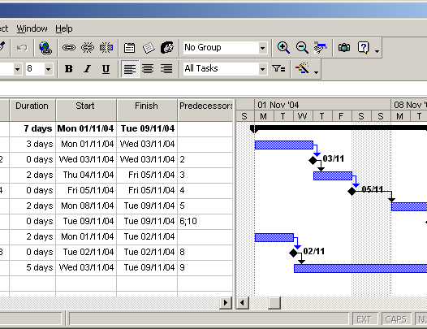
Gantt Charts
GANTT charts are a project planning tool that can be used to represent the timing of tasks required to complete a project.
It describes similar information to a PERT chart.
Here is one that was produced automatically with a project management tool from the PERT chart info above:

Slide 104
Quality process as Input`
This quality process can be viewed as a framework for arranging and selecting quality activities satisfying a goal.
Quality goals should ensure dependability properties( within a time period without arguing).
Explicitly mention quality factors at specification as these activities have constraint and tradeoffs.

Slide 105
Quality Process as Output
Quality Process
Completeness
Timeliness
Cost Effectiveness

Slide 106
Quality Process should check
Completeness means that appropriate activities are planned to detect each important class of faults.
What the important classes of faults are depends on the application domain, the organization, and the technologies employed (e.g., memory leaks are an important class of faults for C++ programs, but seldom for Java programs).
Timeliness means that faults are detected at a point of high leverage, which in practice almost always means that they are detected as early as possible.
Cost-effectiveness means that, subject to the constraints of completeness and timeliness, one chooses activities depending on their cost as well as their effectiveness.
Cost must be considered over the whole development cycle and product life, so the dominant factor is likely to be the cost of repeating an activity through many change cycles.

Slide 107
Quality process-Rule Of Thumb
Never put of quality activities until late in the project.
Because of two reasons:
1. Fault preventing activities comes under coordination with other activities
For example, architectural design of a software system has an enormous impact on the test and analysis approaches that will be feasible and on their cost.
2. Cost factor, repairing the cost of a software defect.
For example, early test planning during requirements engineering typically clarifies and improves requirements specifications.

Slide 108
Planning and Monitoring-Objective
Achieving Process Visibility
How does our progress compare to our plan?
Not only in terms of schedule visibility but it should be progress against quality goals
Should gain confidence in quality before final testing .

Slide 109
Planning and Monitoring
Achieve early visibility
Arranging activities to be cost-effective
For example, one designs test cases at the earliest opportunity (not "just in time") and uses both automated and manual static analysis techniques on software artifacts that are produced before actual code.

Slide 110
Quality Goals and Planning
Quality goals can be achieved only by careful planning of activities and these activities match to identified project objectives.
Planning is part of quality process and its is elaborated and revised throughout the project.
Analysis and testing identifies company or project wide standards that must be satisfied:
Procedures for obtaining quality certificates required for certain class of products, techniques and tools.
Some companies follow ISO 9000 or Capability Maturity Model. All these need detailed documentation and management of analysis and test activities and well defined phases.

Slide 111
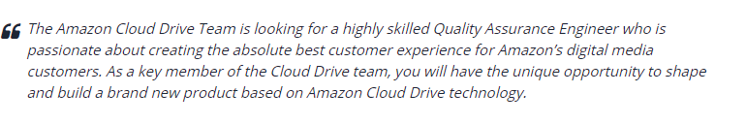
QA

Slide 112


Slide 113
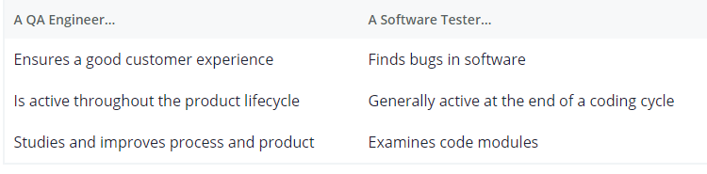
Differences

Slide 114
Analysis and Test Plan
It indicates objectives and scope of the test and analysis activities;
it describes documents and other items that must be available for performing the planned activities, integrating the quality process with the software development process;
it identifies items to be tested, thus allowing for simple completeness checks and detailed planning;
it distinguishes features to be tested from those not to be tested;
it selects analysis and test activities that are considered essential for success of the quality process; and
finally it identifies the staff involved in analysis and testing and their respective and mutual responsibilities.

Slide 115
Planning and Monitoring
The final analysis and test plan includes additional information that illustrates constraints, pass and fail criteria, schedule, deliverables, hardware and software requirements, risks, and contingencies.
Constraints indicate deadlines and limits that may be derived from the hardware and software implementation of the system under analysis and the tools available for analysis and testing.
Pass and fail criteria indicate when a test or analysis activity succeeds or fails, thus supporting monitoring of the quality process.
The schedule describes the individual tasks to be performed and provides a feasible schedule.
Deliverables specify which documents, scaffolding and test cases must be produced, and indicate the quality expected from such deliverables.
Hardware, environment and tool requirements indicate the support needed to perform the scheduled activities.
The risk plan identifies the possible problems and provides recovery actions to avoid major failures.

Slide 116
Quality Goals
Which team will fail in product development?
Think beyond restrictions in terms of scheduling, not enough resources, not enough budget.
I need answer in terms of quality process

Slide 117
How do you set quality goals for a
software process?

Slide 118
Quality Goals
Process visibility requires a clear specification of goals, and in the case of quality process visibility this includes a careful distinction among dependability qualities.
A team that does not have a clear idea of what factors are important and what factors are not will not succeed in product development.
Goals are needed to be refined into a clear and reasonable set of objectives.
Quality goals of one project varies from another project.
For some time to market is important and for some safety is important.

Slide 119
Quality Goals
The relative importance of qualities and their relation to other project objectives varies.
Time-to-market may be the most important property for a mass market product, usability may be more prominent for a Web based application, and safety may be the overriding requirement for a life-critical system.
Product qualities are the goals of software quality engineering, and process qualities are means to achieve those goals.

Slide 120
Quality Goals
Software product qualities can be divided into those that are directly visible to a client (external) and those that primarily affect the software development organization.(internal)
Reliability, for example, is directly visible to the client.
Maintainability primarily affects the development organization, although its consequences may indirectly affect the client as well, for example, increasing the time between product releases.
Properties that are directly visible to users of a software product, such as dependability, latency, usability, and throughput, are called external properties.
Properties that are not directly visible to end users, such as maintainability, reusability, and traceability, are called internal properties.

Slide 121
Quality Goals
Most important task in software quality analysis is to make desired properties explicit, as properties that are unspecified may eventually surface unpleasantly when we discover that they are not met.
Most of the cases its better to specify implicit properties also Cleary.
Its better to mention usability property explicitly than assuming developer or tester will consider.

Slide 122
Dependability Properties
/
So now you know what is dependability property?
Which dependable properties are directly influenced by specification?

Slide 123
Dependability Properties
Correctness
The simplest of the dependability properties is correctness:
A program or system is correct if it is consistent with its specification.
By definition, a specification divides all possible system behaviors into two classes, successes (or correct executions) and failures.
All of the possible behaviors of a correct system are successes.
A program cannot be mostly correct or somewhat correct or 30% correct. It is absolutely correct on all possible behaviors, or else it is not correct.

Slide 124
Reliability
Reliability is a statistical approximation to correctness, in the sense that 100% reliability is indistinguishable from correctness.
Roughly speaking, reliability is a measure of the likelihood of correct function for some "unit" of behavior, which could be a single use or program execution or a period of time.
Like correctness, reliability is relative to a specification (which determines whether a unit of behavior is counted as a success or failure).
Unlike correctness, reliability is also relative to a particular usage profile. The same program can be more or less reliable depending on how it is used.

Slide 125
Reliability
Availability is an appropriate measure of time for which the system is available to user and providing desired functionality.
For example, a failure of a network router may make it impossible to use some functions of a local area network until the service is restored; between initial failure and restoration we say the router is "down" or "unavailable." The availability of the router is the time in which the system is "up" (providing normal service) as a fraction of total time. Thus, a network router that averages 1 hour of down time in each 24-hour period would have an availability of 23/24, or 95.8%.

Slide 126
Reliability
Mean time between failures (MTBF) is yet another measure of reliability, also using time as the unit of execution.
The hypothetical network switch that typically fails once in a 24hour period and takes about an hour to recover has a mean time between failures of 23 hours.

Slide 127
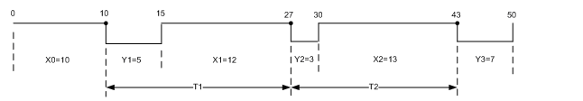
How do you calculate MTBF?
Assume you are testing a system that can be repaired when there is a failure. The failures causes the system to go down. The first failure happens at 10 hours and it takes 5 hours to fix. The second failure is at 27 hours and the repair duration is 3 hours. Then after working for 13 hours, the system fails at 43 hours. The repair lasts for 7 hours and the system is restored at 50 hours. This failure and repair process can be illustrated using the following graph.

Slide 128
Safety
Is safety an aspect of correctness?
Does good specification mean good safety?

Slide 129
Safety
Safety is concerned with preventing certain undesirable behaviors, called hazards.
It is quite explicitly not concerned with achieving any useful behavior apart from whatever functionality is needed to prevent hazards.
Software safety is typically a concern in "critical" systems such as avionics and medical systems, but the basic principles apply to any system in which particularly undesirable behaviors can be distinguished from failure.
For example, while it is annoying when a word processor crashes, it is much more annoying if it irrecoverably corrupts document files.

Slide 130
Safety
Just as correctness is meaningless without a specification of allowed behaviors, safety is meaningless without a specification of hazards to be prevented, and in practice the first step of safety analysis is always finding and classifying hazards.
Typically, hazards are associated with some system in which the software is embedded (e.g., the medical device), rather than the software alone.
The distinguishing feature of safety is that it is concerned only with these hazards, and not with other aspects of correct functioning.

Slide 131
Robustness
Correctness and reliability depend upon normal operating conditions.
It is not reasonable to expect a word processing program to save changes normally when the file does not fit in storage, or to expect a database to continue to operate normally when the computer loses power, or to expect a Web site to provide completely satisfactory service to all visitors when the load is 100 times greater than the maximum for which it was designed.
Software that fails under these conditions, which violate the premises of its design, may still be "correct" but we need to verify how system behaves when these conditions occur.

Slide 132
Robustness
It is acceptable that the word processor fails to write the new file that does not fit on disk, but it is unacceptable if it corrupts the previous version of the file in attempt.
It is acceptable for the database system to cease to function when the power is cut, but unacceptable for it to leave the database in a corrupt state.
Consider a website handling 1000 users and when users increases then it is preferable for the Web system to turn away some arriving users rather than becoming too slow for all, or crashing.
Software that gracefully degrades or fails "softly" outside its normal operating parameters is robust.

Slide 133
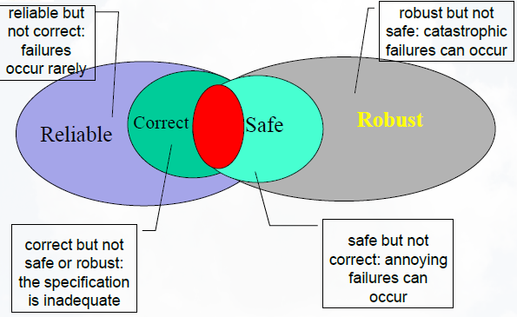
Relation among dependability properties

Slide 134
Analysis
Analysis does not involve execution of actual code .
There are two types of analysis
Manual inspection
Automated analysis
Analysis is well suited for early stages of specification and design where we don't have executable code.
Inspection is applied to document and to code.
Automated Static Analysis can be applied to documents like specification where we have UML diagrams not to documents with natural language.
Static analysis is a method of computer program verifying code without executing the program. Automated tools will assist us in conducting static analysis.

Slide 135
Improving the process
Goal of the quality process is to find the different ways in which we can find the defects.
We need to find defects which are more expensive. Defects need to be found and correct at early stages of s/w development.
We can improve the process used for s/w development and testing by feedback from the all the stages of process.
Quality process can be improved by classifying different defects and conducting root cause analysis for each defect.

Slide 136
Organizational factors
Quality process or designing a product with good quality not only depends on tools, process but they do depend on people building product.
There are many organizational factors affect quality process :
Poor allocation of responsibility.
Conflict in team.
Poor interaction among developer and tester.
Management not willing to buy sophisticated tools for development and testing process.
Cost factor.

Slide 137
Question 1
If I am downloading a very large file over a slow modem, do I care more about
the availability of my internet service provider or its mean time between failures?

Slide 138
Question 2
Consider responsiveness as a desirable property of an Internet chat program. The informal requirement is that messages typed by each member of a chat session appear instantaneously on the displays of other users. Refine this informal requirement into a concrete specification that can be verified. Is anything lost in the refinement?

Slide 139
Planning and Monitoring the Process

Slide 140
In terms of Testing
How planning and Monitoring is done?

Slide 141
Quality and Process
Quality process: Set of activities and responsibilities
focused primarily on ensuring adequate dependability
concerned with project schedule or with product usability
A framework for
selecting and arranging activities
considering interactions and trade-offs
Follows the overall software process in which it is embedded
Example: waterfall software process ––> “V model”: unit testing starts with implementation and finishes before integration
Example: XP and agile methods ––> emphasis on unit testing and rapid iteration for acceptance testing by customers
Notes:
20.2 Quality and process

Slide 142
Verification Steps for Intermediate Artifacts
Internal consistency checks
compliance with structuring rules that define “well-formed” artifacts of that type
a point of leverage: define syntactic and semantic rules thoroughly and precisely enough that many common errors result in detectable violations
External consistency checks
consistency with related artifacts
Often: conformance to a “prior” or “higher-level” specification
Generation of correctness hypothesis
Correctness hypothesis: lay the groundwork for external consistency checks of other work products
Often: motivate refinement of the current product

Slide 143

Why Clean room process?
What's the issue?

Slide 144
What is Clean room process?
Building a new product by doing reverse engineering of the existing product.
Eventhough replication patent and copyright infringement is avoided.
Eg:Linux Book

Slide 145
Why clean room process in planning and monitoring?
Focus on
Focus on development process
Avoid
avoid dependence on costly defect-removal processes by writing code increments right the first time and verifying their correctness before testing.
Team
team-oriented process that makes development more manageable and predictable because it is done under statistical quality control.

Slide 146

How its different from traditional process model?
Development
Unit Testing
Debugging
Defect Removal

Slide 147
Clean room process model
The Cleanroom process model, introduced by IBM in the late 1980s, pairs development with V&V activities and stresses analysis over testing in the early phases.
The Cleanroom process involves two cooperating teams, the development and the quality teams, and five major activities: specification, planning, design and verification, quality certification, and feedback.

Slide 148
Good Quantitative results
Intended to be “Quick and Clean” not Quick and Dirty

Slide 149
Example Process: Cleanroom
Customer Requirements
Specification
Function
Usage
Incremental
Development
Planning
Functional specifications
Usage specifications
Formal Design
Correctness Verification
Statistical test case generation
Source code
Test cases
Statistical testing
Interfail times
Improvement Feedback
Quality Certification Model
MTTF statistics
Notes:
SIDEBAR -- example of ntertwining between development and quality activities

Slide 150
Cleanroom-Incremental Development
Cleanroom development involves two cooperating teams and five major activities:
Requirements:
Like any model, this also starts with specification
Two specifications:
Functional
Usage
Large team may have specific specification team

Slide 151
Specification
Functional Specification | Usage Specification
defines the required external system behavior in all circumstances of use | the usage specification detines usage scenarios and their probabilities for all possible system usage, both correct and incorrect
Basis for incremental software development | Basis for generating test cases for incremental statistical testing and quality certification
Defined in requirements | Explained in certification

Slide 152
Increment Planning
Based on specifications, the development and certification teams together define an initial plan for developing increments that will accumulate into the final system.
For example, a 100 KLOC system might be developed in five increments averaging 20 KLOC each. The time it cakes to design and verify increments varies with their size and complexity. Increments that require long lead times may call for parallel development.

Slide 153
Design and Verification
The development team then carries out a design and correctness verification cycle for each increment.
The certification team proceeds in parallel, using the usage specification to generate test cases that reflect the expected use of the accumulating increments

Slide 154
Quality Certification
Periodically, the development team integrates a completed increment with prior increments and delivers them to the test team for execution of statistical test cases.
The test cases are run against the functional specification.
Interfail times, that is, the elapsed dines between failures, are passed to a quality-certification model' that computes objective statistical measures of quality, such as mean time to failure.
The quality-certification model employs a reliability growth estimator to derive the statistical measures.
Certification is done continuously, over the life of the project. Higher level increments enter the certification pipeline first. This means major architectural and design decisions are validated in execution before the development team elaborates on them. And because certification is done for all increments as they accumulate, higher level increments are subjected to ginore testing than lower level increments, which implement localized functions.

Slide 155
Feedback
Errors are returned to the development team for correction.
If the quality is low, managers and team members initiate process improvement.
As with any process, a good deal of iteration and feedback is always present to accommodate problems and solutions.

Slide 156
Why reliability-based testing approach?
understand the characteristics of how and why software fails, and try to quantify software reliability
how to quantify software reliability still remains largely unsolved.

Slide 157
SRET
The software reliability engineered testing (SRET) approach, developed at AT&T in the early 1990s, assumes a spiral development process.
SRET identifies two main types of testing: development testing, used to find and remove faults in software at least partially developed in-house.
certification testing, used to either accept or reject outsourced software.
The SRET approach includes seven main steps.
Two initial, quick decision-making steps determine which systems require separate testing and which type of testing is needed for each system to be tested. The five core steps are executed in parallel with each coil of a spiral development process

Slide 158
Example Process: Software Reliability Engineering Testing (SRET)
Define “Necessary” Reliability
Development Operational Profiles
Prepare for Testing
Interpret Failure Data
Execute tests
Requirements and Architecture
Design and Implementation
System Test and
Acceptance Test
Notes:
SIDEBAR

Slide 159
Define “Necessary” Reliability
Determine operational models, that is, distinct patterns of system usage that require separate testing,
classify failures according to their severity, and engineer the reliability strategy with fault prevention, fault removal, and fault tolerance activities.

Slide 160
Develop Operational Profiles
Develop both overall profiles that span operational models and operational profiles within single operational models.
An operational profile describes in quantitative terms how the system is used by a user.
“When the system is in this condition, how great is the chance that this action will be carried out by the user?”

Slide 161
Example Process: Extreme Programming (XP)
Next version
Incremental Release
Review,
Refine, prioritize
pass
Generate User Stories
Create Unit Tests
Pair Programming
+ unit testing
Passed all
unit tests
Acceptance Testing
Failed acceptance test
Create Acceptance Tests
Notes:
SIDEBAR

Slide 162
Strategies vs Plans
 | Strategy | Plan
Scope | Organization | Project
Structure and content based on | Organization structure, experience and policy over several projects | Standard structure prescribed for project
Evolves | Slowly, with organization and policy changes | Quickly, adapting to project needs

Slide 163
Test and Analysis Strategy
Lessons of past experience
an organizational asset built and refined over time
Strategy is essential for :-
avoiding recurring errors
maintaining consistency of the process
increasing development efficiency
Strategy provides guidance and general framework for developing quality plan for several projects.
Quality strategy is important assets for organization as it prescribes set of solutions to problems specific to that organization.
Notes:
20.3

Slide 164
Considerations in Fitting a Strategy to an Organization
Structure and size
example
Distinct quality groups in large organizations, overlapping of roles in smaller organizations
greater reliance on documents in large than small organizations
Overall process
example
Cleanroom requires statistical testing
fits with tight, formal specs and emphasis on reliability
XP prescribes “test first” and pair programming
fits with changing specifications and rapid evolution
Application domain
example
Safety critical domains may impose particular quality objectives and require documentation for certification

Slide 165
Elements of a Strategy
Common quality requirements that apply to all or most products
unambiguous definition and measures
Set of documents normally produced during the quality process
contents and relationships
Activities prescribed by the overall process
standard tools and practices
Guidelines for project staffing and assignment of roles and responsibilities
Notes:
FOR AN EXAMPLE OF TEST STRATEGY SEE CHAPTER 24

Slide 166
Test and Analysis Plan
An analysis and test plan consists of steps to be taken in a particluar project.
A plan should answer the following questions:
What quality activities will be carried out?
What are the dependencies among the quality activities and between quality and other development activities?
What resources are needed and how will they be allocated?
How will both the process and the product be monitored?
Notes:
20.4 Test and analysis plan

Slide 167
Main Elements of a Plan
Items and features to be verified
Scope and target of the plan
Activities and resources
Constraints imposed by resources on activities
Approaches to be followed
Methods and tools
Criteria for evaluating results

Slide 168
Quality Goals
Expressed as properties satisfied by the product
must include metrics to be monitored during the project
example: before entering acceptance testing, the product must pass comprehensive system testing with no critical or severe failures
not all details are available in the early stages of dev
Initial plan
based on incomplete information
incrementally refined

Slide 169
Task Schedule
Initially based on
quality strategy
past experience
Breaks large tasks into subtasks
refine as process advances
Includes dependencies
among quality activities
between quality and development activities
Guidelines and objectives:
schedule activities for steady effort and continuous progress and evaluation without delaying development activities
schedule activities as early as possible
increase process visibility (how do we know we’re on track?)

Slide 170
Sample Schedule
Notes:
The most commmon style of project schedule is the GANTT chart, like this example.
Simple idea: task breakdown with allocation in time, obeying task dependences.
Any “vertical slice” of the graph describes level of effort.
Next slide: we can evaluate the schedule risk in the schedule, and improve it.

Slide 171
Schedule Risk
critical path = chain of activities that must be completed in sequence and that have maximum overall duration
Schedule critical tasks and tasks that depend on critical tasks as early as possible to
provide schedule slack
prevent delay in starting critical tasks
critical dependence = task on a critical path scheduled immediately after some other task on the critical path
May occur with tasks outside the quality plan (part of the project plan)
Reduce critical dependences by decomposing tasks on critical path, factoring out subtasks that can be performed earlier
Notes:
Where are the problems in the schedule?
A: The risks are where any schedule slippage will ripple through the whole
project. We can identify these “critical paths” and rearrange the schedule
to make it more resilient.
We must consider the whole project plan, not just the quality plan, to recognize
all the critical dependencies.
Sometimes the rearrangement requires further task breakdown (factoring) so that
some subtasks can be moved earlier.

Slide 172
Where are the problems in the schedule?
The risks are where any schedule slippage will ripple through the whole project. We can identify these “critical paths” and rearrange the schedule to make it more resilient.
We must consider the whole project plan, not just the quality plan, to recognize all the critical dependencies.
Sometimes the rearrangement requires further task breakdown (factoring) so that some subtasks can be moved earlier.

Slide 173
Reducing the Impact of Critical Paths
Task name |  | January | Febrary | March | April | May
CRITICAL SCHEDULE
Project start
Analysis and design
Code and integration
Design and execute subsystem tests
Design and execute system tests
Produce user documentation
Product delivery
Delay can be tolerated
Notes:
Here (in a very waterfall-like schedule) we see an example of a critical path that we would like to improve,
so that we are not so vulnerable to any schedule slippage.
We can see that designing and executing tests are on the critical path. Factoring them can improve the schedule.

Slide 174
Reducing the Impact of Critical Paths
Task name |  | January | Febrary | March | April | May
UNLIMITED RESOURCES
Project start
Analysis and design
Code and integration
Design subsystem tests
Design system tests
Produce user documentation
Execute subsystem tests
Execute system tests
Product delivery
Notes:
By factoring “design and execute tests” into a test design activity and a test execution activity,
we can move the design tasks earlier in the schedule, and provide much more schedule flexibility.
The refactored schedule now has too much effort concentrated in mid-February, so next
we should level it out a bit ...

Slide 175
Reducing the Impact of Critical Paths
Task name |  | January | Febrary | March | April | May
LIMITED RESOURCES
Project start
Analysis and design
Code and integration
Design subsystem tests
Design system tests
Produce user documentation
Execute subsystem tests
Execute system tests
Product delivery
Notes:
Here we level the effort out, respecting dependences (drawn here as arrows).
We could do much more by breaking “Analysis and design” and “code and integration” into
smaller parts, and interspersing test execution as well as test design with the design and
construction effort.

Slide 176
Reducing the Impact of Critical Paths
Notes:
Here we summarize the overall rescheduling -
Critical schedule before refactoring
Refactoring and scheduling without respect to resources
Leveling the effort to use limited resources (people)

Slide 177
Gantt chart Define the Project:

Slide 178
Risk Planning/management What is risk planning and the strategies?
Risks cannot be eliminated, but they can be assessed, controlled, and monitored
Generic management risk
personnel
technology
schedule
Quality risk
development
execution
requirements
Notes:
The schedule rearrangement we just considered was an example of risk planning:
Making the project less vulnerable to a particular kind of risk
(the risk that some activities take longer than planned).
We don’t seek to eliminate risks, because we can’t. We seek to
Assess them: Explicitly consider what the risks are
Control them: Reduce (but not eliminate) vulnerabilities
Monitor them: The “visibility” aspect, making sure we are alerted
as soon as possible if some of the risks come to pass, so we can
minimize the cost of dealing with them.
The most important thing is to invest time and effort in thinking explicitly what
risks a project could be vulnerable to, as specifically as possible. The most
dangerous risks by far are those that were never considered in the plan.
In addition to this “schedule risk”, we need to control vulnerabilty to
several other kinds of risks (elaborated in subsequent slides).

Slide 179
Personnel
Control Strategies
cross training to avoid over-dependence on individuals
continuous education
identification of skills gaps early in project
competitive compensation and promotion policies and rewarding work
including training time in project schedule
Example Risks
Loss of a staff member
Staff member under-qualified for task
Notes:
20.5 Risk Planning
The most important resource in a software project is people, and the biggest risk
is losing people. This risk grows with the length and size of the project. For large
or long projects, it is very likely that some key people will leave before project completion.
We may reduce the likelihood of people leaving by making the job as attractive as possible
(and this requires much more than a good salary --- the work must be rewarding!). Since
we cannot make this risk very small, most of the control strategies involve making it easier
to recover when someone does leave.
Note that all of the control strategies have costs. We must balance the
potential cost of risks with the cost of risk control. (It is much more common
to invest too little in risk control than to invest too much.)

Slide 180
Technology
Example Risks
High fault rate due to unfamiliar COTS component interface
Test and analysis automation tools do not meet expectations
Control Strategies
Anticipate and schedule extra time for testing unfamiliar interfaces.
Invest training time for COTS components and for training with new tools
Monitor, document common errors and correct
Introduce new tools in lower-risk projects or prototyping exercises
Notes:
Short for commercial off-the-shelf, an adjective that describes software or hardware products that are ready-made and available for sale to the general public. For example, Microsoft Office is a COTS product that is a packaged software solution for businesses.
While technology risks are typically smaller than personnel risks, it is not
uncommon for a project to run into problems, especially with
commercial off-the-shelf (COTS) components that do not work or
integrate as well as anticipated. Early evaluation of COTS components
is therefore an important part of a good quality plan.
Similar considerations apply to adoption of new test and
analysis tools --- we must anticipate and make contingency
plans for them not working as expected and desired.
apply to new tools for auutom

Slide 181
Schedule
Example Risks
Inadequate unit testing leads to unanticipated expense and delays in integration testing
Difficulty of scheduling meetings makes inspection a bottleneck in development
Control Strategies
Track and reward quality unit testing as evidenced by low fault densities in integration
Set aside times in a weekly schedule in which inspections take precedence over other meetings and work
Notes:
These are just two examples of schedule risks and potential control strategies.
We have already discussed the generic strategy of refactoring tasks on
critical paths to reduce vulnerability to schedule slippage rippling through the whole
project.
Other schedule risks specific to quality activities can be anticipated primarily from experience with similar projects earlier.

Slide 182
Development
Control Strategies
Provide early warning and feedback
Schedule inspection of design, code and test suites
Connect development and inspection to the reward system
Increase training through inspection
Require coverage or other criteria at unit test level
Example Risks
Poor quality software delivered to testing group
Inadequate unit test and analysis before committing to the code base(collection of whole software components)

Slide 183
Test Execution
Example Risks
Execution costs higher than planned
Insufficient resources for testing
Control Strategies
Increase intermediate feedback
Invest in scaffolding

Slide 184
Requirements
Example Risk
critical requirements increase expense and uncertainty
Control Strategies
Balance test and analysis
Isolate critical parts, concerns and properties

Slide 185
Process Monitoring
Identify deviations from the quality plan as early as possible and take corrective action
Depends on a plan that is
realistic
well organized
sufficiently detailed with clear, unambiguous milestones and criteria
A process is visible to the extent that it can be effectively monitored

Slide 186
How can we identify deviations from the quality plan with respect to effectiveness and quality, and not just schedule of tasks? Our best tool is often analogy: Gather data and compare it to data from previous projects
In typical projects, the total number of open faults rises during early stages of construction and then falls as the product nears readiness;
Severe and critical faults display this pattern more strongly than less critical faults.
Comparing fault data on the current project to the history of similar projects (preferably for the same organization, and as similar as possible) provides a rough guide to progress. Large deviations from historical patterns should be explained.
If we don’t see the predicted rise in the number of detected faults early in the project, we need to learn whether it is because of unusually high quality or unusually poor test and analysis.
If we don’t see severe and criitical paths decreasing, is it because development is still unstable, introducing new faults with changes?
Analysis by analogy (comparison to history) is far from perfect, but it is often the best tool available for recognizing problems before they become critical.

Slide 187
Evaluate Aggregated Data by Analogy
faults
Builds
Notes:
How can we identify deviations from the quality plan with respect to effectiveness and quality, and not
just schedule of tasks? Our best tool is often analogy: Gather data and compare it to data from previous projects.
In typical projects, the total number of open faults rises during early stages of construction and then falls as the product nears readiness;
Severe and critical faults display this pattern more strongly than less critical faults.
Comparing fault data on the current project to the history of similar projects (preferably for the same organization, and as
similar as possible) provides a rough guide to progress. Large deviations from historical patterns should be explained.
If we don’t see the predicted rise in the number of detected faults early in the project, we need to learn whether it is
because of unusually high quality or unusually poor test and analysis. If we don’t see severe and criitical paths decreasing,
is it because development is still unstable, introducing new faults with changes?
Analysis by analogy (comparison to history) is far from perfect, but it is often the best tool available for
recognizing problems before they become critical.

Slide 188
Process Improvement
Monitoring and improvement within a project or across multiple projects:
Orthogonal Defect Classification (ODC)
&Root Cause Analysis (RCA)
Notes:
The next several slides expand on process monitoring, considering not just how to trigger
a contingency plan, but also how to use analysis of fault data to improve the process
of the current project or of future projects. The generic term for this (for all aspects of
project management, as well as quality processes in particular) is “process improvement”.
We illustrate with two well-known approaches, orthogonal defect classification and root cause analysis.

Slide 189
Orthogonal Defect Classification (ODC)
Accurate classification schema
for very large projects
to distill an unmanageable amount of detailed information
Two main steps
Fault classification
when faults are detected
when faults are fixed
2. Fault analysis
Notes:
We already looked at analysis of overall trends (the curves showing number of critical, severe, and moderate
faults known over time). For process improvement we need to break the faults down further, classifying them
so that we can find ways to either prevent or detect them more efficiently. ODC is one way to do this,
especially for large projects with a large amount of raw data (e.g., a large number of bug reports in a
bug tracking database).

Slide 190
ODC Fault Classification
When faults are detected
activity executed when the fault is revealed
trigger that exposed the fault
impact of the fault on the customer
When faults are fixed
Target: entity fixed to remove the fault
Type: type of the fault
Source: origin of the faulty modules (in-house, library, imported, outsourced)
Age of the faulty element (new, old, rewritten, re-fixed code)

Slide 191
ODC classification of triggers listed by activity
Review and Code Inspection
Design Conformance:
Logic/Flow
Backward Compatibility
Internal Document
Concurrency
Structural (White Box) Test
Simple Path
Complex Path
Functional (Black box) Test
Coverage
Interaction
System Test
Workload/Stress
Recovery/Exception
Hardware Configuration
Software Configuration

Slide 192
ODC classification of customer impact
Installability
Integrity/Security
Performance
Maintenance
Usability
Reliability
Requirements

Slide 193
Fault Analysis
What kind of fault is being detected (fault types versus activities)
what kind of test or use case triggered detection
(3) how long faults remain in code before detection
(4) Patterns in the kinds of faults being detected

Slide 194
ODC Fault Analysis (example 1/4)
1.Distribution of fault types versus activities
Different quality activities target different classes of faults
example: algorithmic faults are targeted primarily by unit testing.
Activity: A high proportion of faults detected by unit testing should belong to this class
If proportion of algorithmic faults found during unit testing
unusually small
larger than normal
unit tests may not have been well designed
proportion of algorithmic faults found during unit testing unusually large
integration testing may not focused strongly enough on interface faults
Notes:
In this example (spread over 4 slides), we consider analyses of
* (1) when each kind of fault is being detected (fault types versus activities)
* (2) what kind of test or use case triggered detection
* (3) how long faults remain in code before detection
* (4) trends in the kinds of faults being detected
Each of these can suggest problems (and opportunities for improvement) in test and analysis

Slide 195
ODC Fault Analysis (example 2/4)
Distribution of triggers over time during field test
Faults corresponding to simple usage should arise early during field test, while faults corresponding to complex usage should arise late.
The rate of disclosure of new faults should asymptotically decrease
Unexpected distributions of triggers over time may indicate poor system or acceptance test
Triggers that correspond to simple usage reveal many faults late in acceptance testing
The sample may not be representative of the user population
Continuously growing faults during acceptance test
System testing may have failed

Slide 196
ODC Fault Analysis (example 3/4)
Age distribution over target code
Most faults should be located in new and rewritten code
The proportion of faults in new and rewritten code with respect to base and re-fixed code should gradually increase
Different patterns
may indicate holes in the fault tracking and removal process
may indicate inadequate test and analysis that failed in revealing faults early
Example
increase of faults located in base code after porting
may indicate inadequate tests for portability

Slide 197
ODC Fault Analysis (example 4/4)
Distribution of fault classes over time
The proportion of missing code faults should gradually decrease
The percentage of extraneous faults may slowly increase, because missing functionality should be revealed with use
increasing number of missing faults
may be a symptom of instability of the product
sudden sharp increase in extraneous faults
may indicate maintenance problems

Slide 198
Improving the Process
Many classes of faults that occur frequently are rooted in process and development flaws.
Examples
architectural design that does not take into account resource allocation can lead to resource allocation faults
Lack of experience with the development environment, which leads to misunderstandings between analysts and programmers on rare and exceptional cases, can result in faults in exception handling.
The occurrence of many such faults can be reduced by modifying the process and environment
examples
Resource allocation faults resulting from architectural design can be reduced by introducing specific inspection tasks
Faults attributable to inexperience with the development environment can be reduced with focused training
Notes:
20.7 Improving the Process

Slide 199
Improving Current and Next Processes
Identifying weak aspects of a process can be difficult
Analysis of the fault history can help software engineers build a feedback mechanism to track relevant faults to their root causes
Sometimes information can be fed back directly into the current product development
More often it helps software engineers improve the development of future products

Slide 200
Root cause analysis (RCA)
Technique for identifying and eliminating process faults
First developed in the nuclear power industry; used in many fields.
Four main steps :-
What are the faults?
When did faults occur? When, and when were they found?
Why did faults occur?
How could faults be prevented?

Slide 201
What are the faults?
Identify a class of important faults
Faults are categorized by
severity = impact of the fault on the product
Kind
No fixed set of categories; Categories evolve and adapt
Goal:
Identify the few most important classes of faults and remove their causes
Differs from ODC: Not trying to compare trends for different classes of faults, but rather focusing on a few important classes

Slide 202
Fault Severity
Level | Description | Example
Critical | The product is unusable | The fault causes the program to crash
Severe | Some product features cannot be used, and there is no workaround | The fault inhibits importing files saved with a previous version of the program, and there is no workaround
Moderate | Some product features require workarounds to use, and reduce efficiency, reliability, or convenience and usability | The fault inhibits exporting in Postscript format. Postscript can be produced using the printing facility, but with loss of usability and efficiency
Cosmetic | Minor inconvenience | The fault limits the choice of colors for customizing the graphical interface, violating the specification but causing only minor inconvenience

Slide 203
Why did faults occur?
Core RCA step
trace representative faults back to causes
objective of identifying a “root” cause
Iterative analysis
explain the error that led to the fault
explain the cause of that error
explain the cause of that cause
...
Rule of thumb
“ask why six times”
Tracing a causes of fault requires experience,judgement,knowlegde
Notes:
There is nothing magic about “six”. The point is to keep pushing back until we find the best opportunity for improvement,
whether that be more effective detection of some kinds of faults or practices that prevent those faults from occurring in
the first place.

Slide 204
How could faults be prevented?
Many approaches depending on fault and process:
From lightweight process changes
example
adding consideration of exceptional conditions to a design inspection checklist
To heavyweight changes:
example
making explicit consideration of exceptional conditions a part of all requirements analysis and design steps
Goal is not perfection, but cost-effective improvement

Slide 205
The Quality Team
The quality plan must assign roles and responsibilities to people
assignment of responsibility occurs at
strategic level
test and analysis strategy
structure of the organization
external requirements (e.g., certification agency)
tactical level
test and analysis plan
Notes:
20.8 The Quality team

Slide 206
Roles and Responsibilities at Tactical Level
balance level of effort across time
manage personal interactions
ensure sufficient accountability that quality tasks are not easily overlooked
encourage objective judgment of quality
prevent it from being subverted by schedule pressure
foster shared commitment to quality among all team members
develop and communicate shared knowledge and values regarding quality

Slide 207
Independent Testing Team
Minimize risks of conflict between roles played by the same individual
Example
project manager with schedule pressures cannot
bypass quality activities or standards
reallocate people from testing to development
postpone quality activities until too late in the project
Increases risk of conflict between goals of the independent quality team and the developers
Plan
should include checks to ensure completion of quality activities
Example
developers perform module testing
independent quality team performs integration and system testing
quality team should check completeness of module tests
Notes:
One approach is to have a testing team distinct from the development team. This has some advantages (minimizing role conflict for individuals),
but increases risk of conflict between quality team and development team.
Considering the distinction between oversight and carrying out a task, it is possible for the independent testing team to
have oversight responsibility for some tasks (e.g., module testing) that is performed by the development team.
The project plan includes checks (process visibility) for satisfactory completion of quality activities.

